Slide 1
RADIO LAYER
By- Guthula Harish Aryan

Slide 2
Radio Layer
The Radio Layer is the lowest defined layer of Bluetooth specification.
It defines air interface, frequency bands, frequency hopping specifications, and modulation techniques.

Slide 3
FREQUENCY
It operates in the unlicensed 2.4 GHz ISM (Industrial, Scientific, and Medical).
Bluetooth uses 79 channels, each 1 MHz wide, within the 2.4 GHz band (2400–2483.5 MHz).

Slide 4
GUARD BAND
Guard bands are placed at the edges of this range to avoid interference with adjacent wireless technologies like Wi-Fi and microwave ovens.
At 2.400 MHz - 2.402 MHz and 2.480 MHz – 2.483.5 MHz
Total of 5.5Mhz of guard band has been used in Bluetooth.

Slide 5
FHSS and AFH
In order to avoid interference from other networks operating in the ISM band, it uses Frequency Hopping Spread Spectrum (FHSS) and Adaptive Frequency Hopping (AFH).
Each device changes its modulation frequency 1600 times per second, i.e. there are 1600 hops/sec. The dwell time is 625 μsec.
It uses adaptive frequency hopping for adjusting its hop sequence to exclude channels where there are other radio-frequency signals (RF signals).

Slide 6
Antenna Height and Wavelength
The height of antenna is typically a fraction of wavelength of signal, it is designed to transmit or receive.
Wavelength for bluetooth is:
λ= c/ f
λ= (3*10^8)/(2.4*10^9)
λ= 12.5cm
If the device uses the quarter wave antenna, then the height of antenna is 3.125cm. If it uses the halfwave antenna, then the height of antenna is 6.25cm.

Slide 7
MODULATIONS USED
GFSK
π/4-QPSK
8DPSK

Slide 8
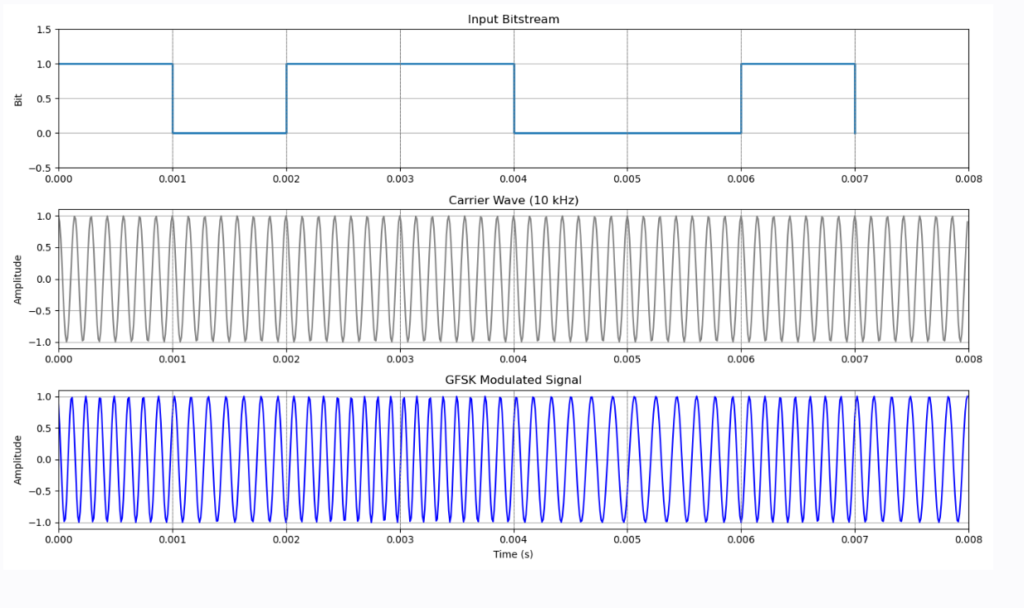
GFSK
During access code and packet header transmission the Basic Rate GFSK modulation mode shall be used.

Slide 9
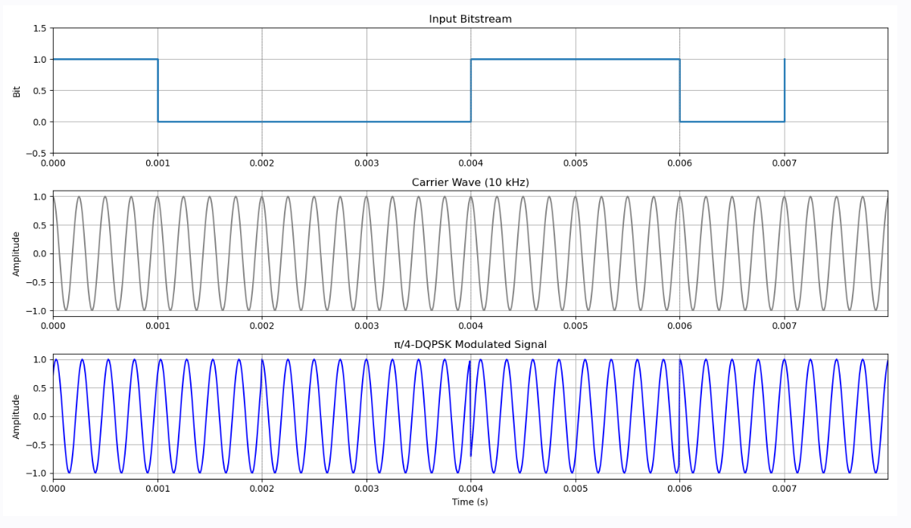
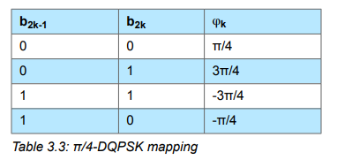
π/4-DQPSK
The PSK modulation format defined for the 2 Mb/s transmission shall be π/4 rotated differential encoded quaternary phase shift keying (π/4-DQPSK).
1
0

Slide 10
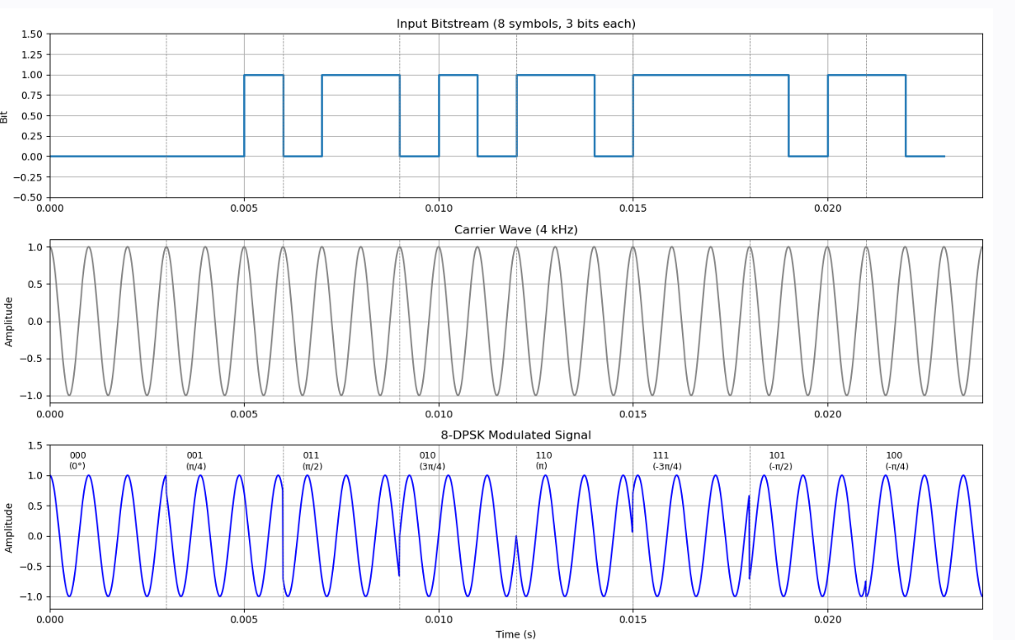
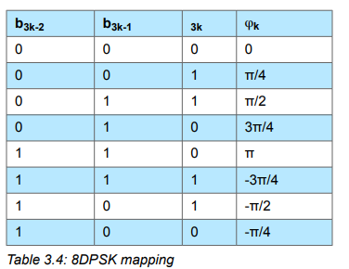
8DPSK
The PSK modulation format defined for the 3 Mb/s transmission shall be differential encoded 8-ary phase shift keying (8DPSK).

Slide 11
SLOTS
ONE SLOT:
The device shall be able to transmit and receive GFSK packets, of any length between 68 µs and 426 µs.
A device that supports π/4-DQPSK modulation shall be able to transmit and receive packets using π/4-DQPSK modulation with a payload field of up to 248 symbols.
A device that supports 8DPSK modulation shall be able to transmit and receive packets using 8DPSK modulation with a payload field of up to 246 symbols.
THREE SLOT:
A device that supports 3-slot packets shall be able to transmit and receive Basic Rate packets of any length between 68 µs and 1686 µs and, if supported, Enhanced Data Rate packets with a payload field of up to 1500 symbols.
FIVE SLOT:
A device that supports 5-slot packets shall be able to transmit and receive Basic Rate packets of any length between 68 µs and 2916 µs and, if supported, Enhanced Data Rate packets with a payload field of up to 2748 symbols.

Slide 12
Thank You

